Slide 1

Journal Meeting 2020-08-13
JuHyeong Kim

Slide 2


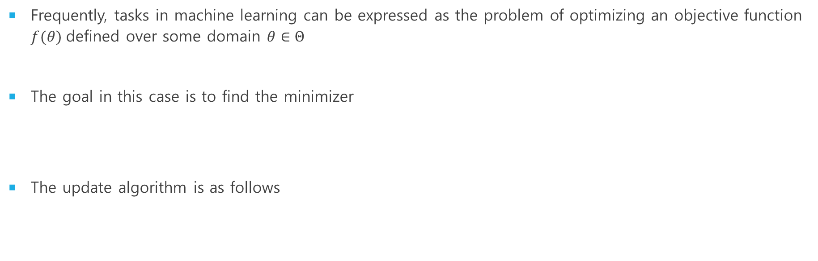
INTRODUction
Frequently, tasks in machine learning can be expressed as the problem of optimizing an objective function $f(θ)$defined over some domain $θ∈Θ$
The goal in this case is to find the minimizer
The update algorithm is as follows
meta-learning acts as an optimizer such as SGD and ADAM.

Slide 3

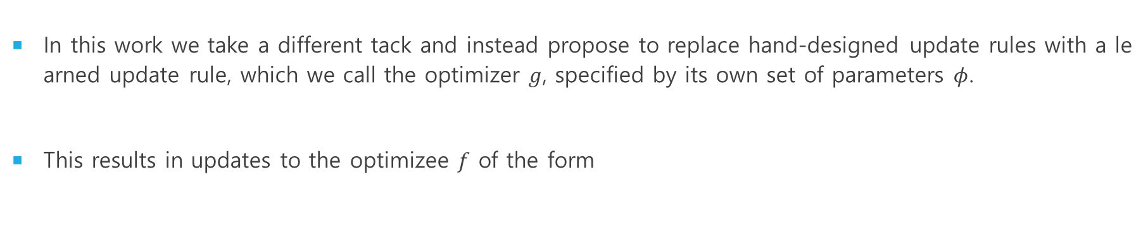
INTRODUction
In this work we take a different tack and instead propose to replace hand-designed update rules with a learned update rule, which we call the optimizer $g$, specified by its own set of parameters $φ$.
This results in updates to the optimizee $f$ of the form
change the update rule

Slide 4
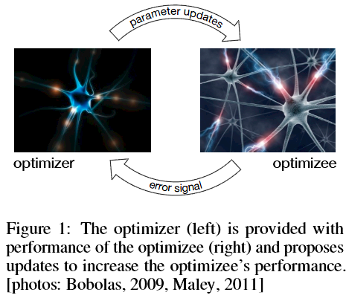
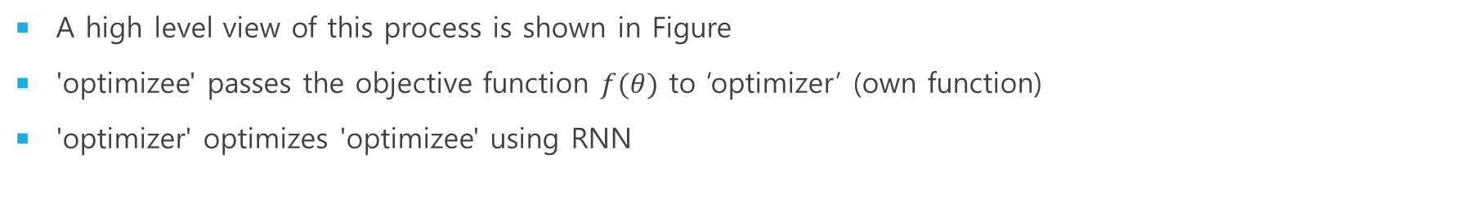
INTRODUction
A high level view of this process is shown in Figure
'optimizee' passes the objective function $f(θ)$ to ‘optimizer’ (own function)
'optimizer' optimizes 'optimizee' using RNN

Slide 5

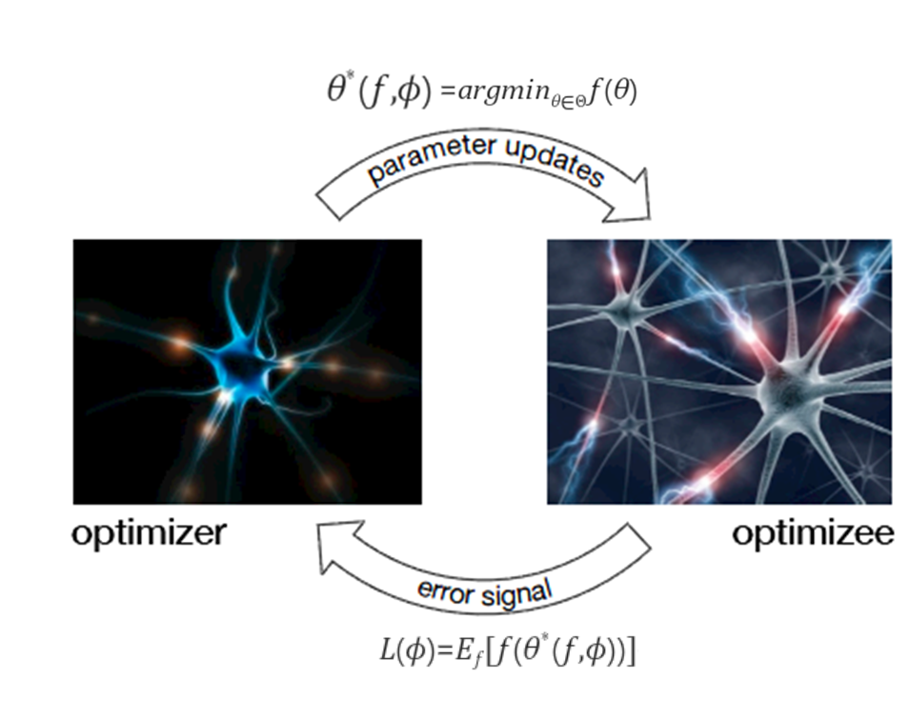

method
Let's show the ‘optimizee’ parameters as a function for the optimizer parameter.
Optimizer parameter optimization is as follows.

Slide 6
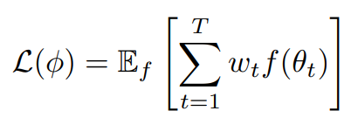


method
Optimizer parameter
Depend on
the whole trajectory
if ${t=T and w}_{t}=1$ ,
=
$\text{Here} \text{are} \text{arbitrary} \text{weights} \text{associated} \text{with} \text{each} \text{time}\text{−}\text{step}$

Slide 7
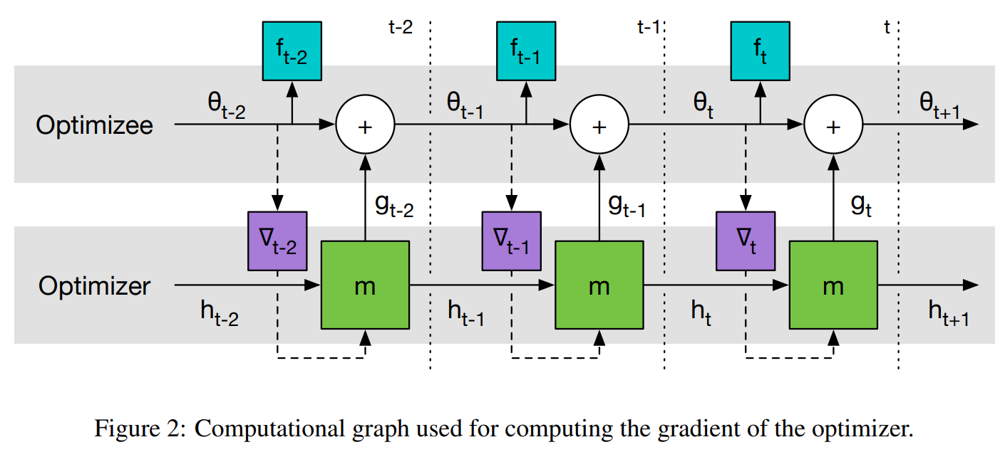
method
Optimization of 'optimizee’ and ‘optimizer’ proceeds as follows.

Slide 8
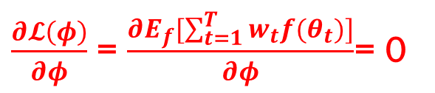
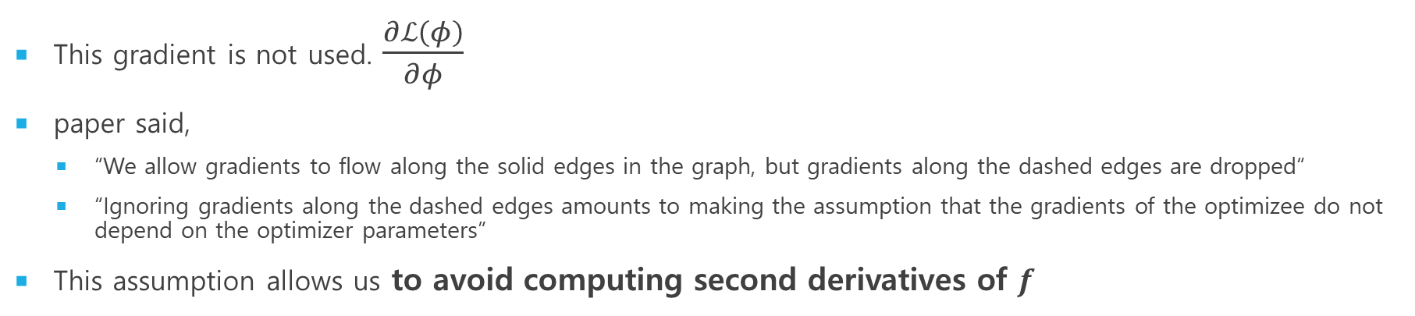
method
This gradient is not used. $\frac{∂ℒ\left(φ\right)}{∂φ}$
paper said,
“We allow gradients to flow along the solid edges in the graph, but gradients along the dashed edges are dropped“
“Ignoring gradients along the dashed edges amounts to making the assumption that the gradients of the optimizee do not depend on the optimizer parameters”
This assumption allows us to avoid computing second derivatives of $f$
$\frac{∂𝓛\left(φ\right)}{∂φ}$ = $\frac{∂Ε_{f}[\sum_{t=1}^{T}{w_{t}f(θ_{t})]}}{∂φ}$= 0

Slide 9
method
Goal →

Slide 10
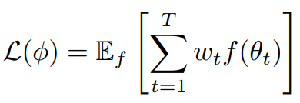
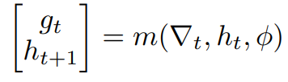
method
Loss Function of Optimizer

Slide 11
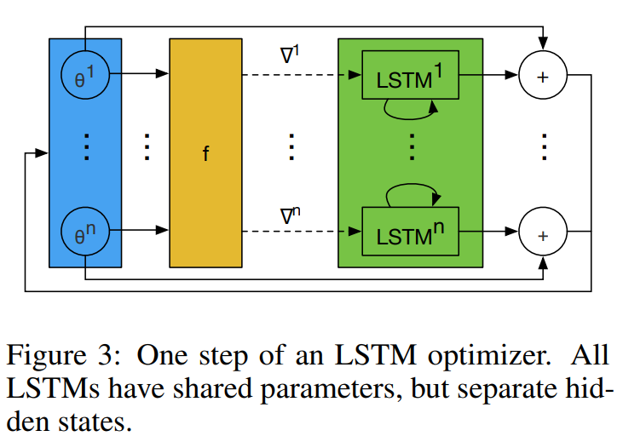
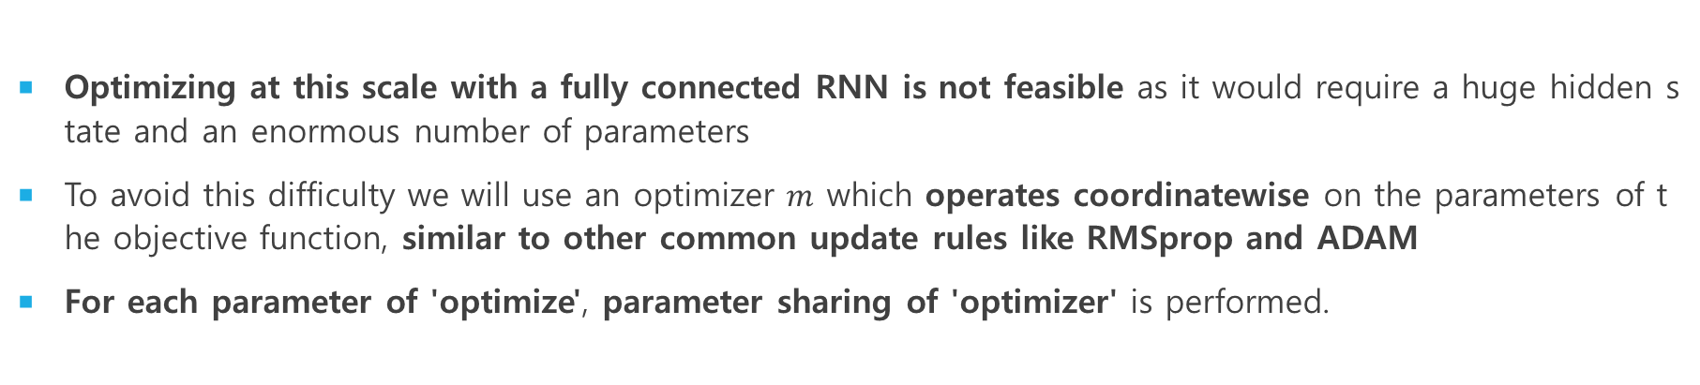
METHOD
Optimizing at this scale with a fully connected RNN is not feasible as it would require a huge hidden state and an enormous number of parameters
To avoid this difficulty we will use an optimizer $m$ which operates coordinatewise on the parameters of the objective function, similar to other common update rules like RMSprop and ADAM
For each parameter of 'optimize', parameter sharing of 'optimizer' is performed.

Slide 12
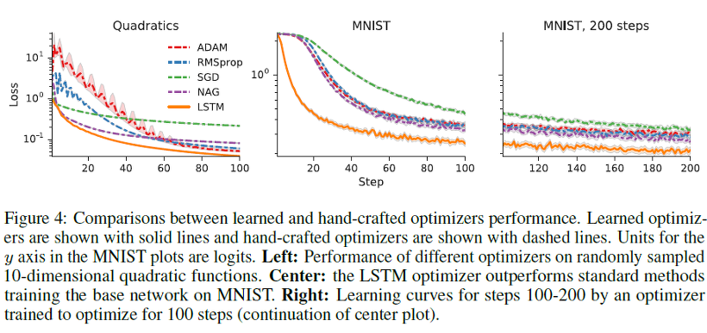
result

Slide 13
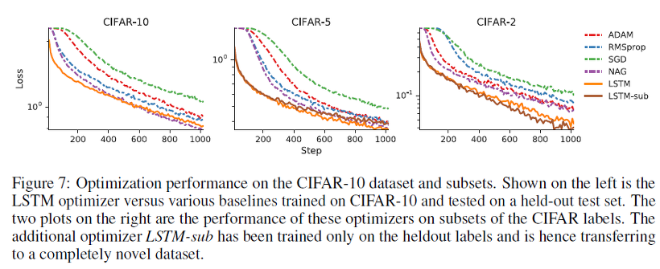
result

Slide 14
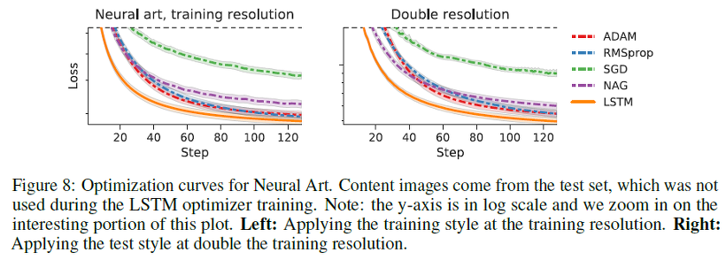
result

Slide 15
paper
https://papers.nips.cc/paper/6461-learning-to-learn-by-gradient-descent-by-gradient-descent.pdf

